Slide 1
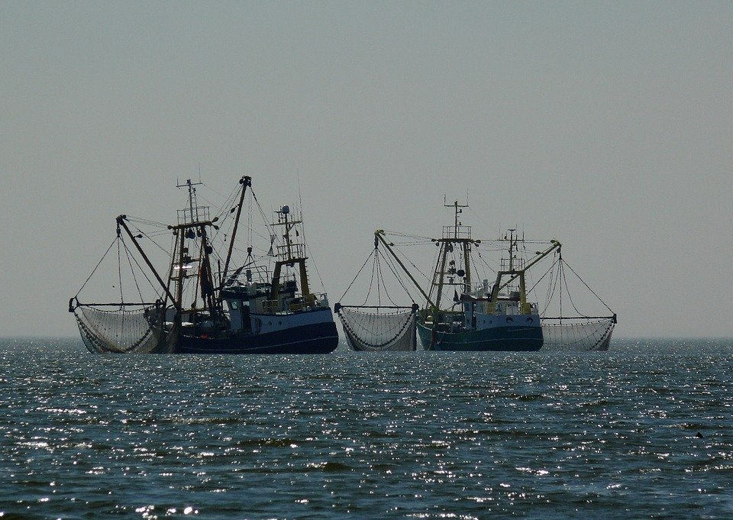

Slide 2
F

Slide 3
F

Slide 4
F

Slide 5
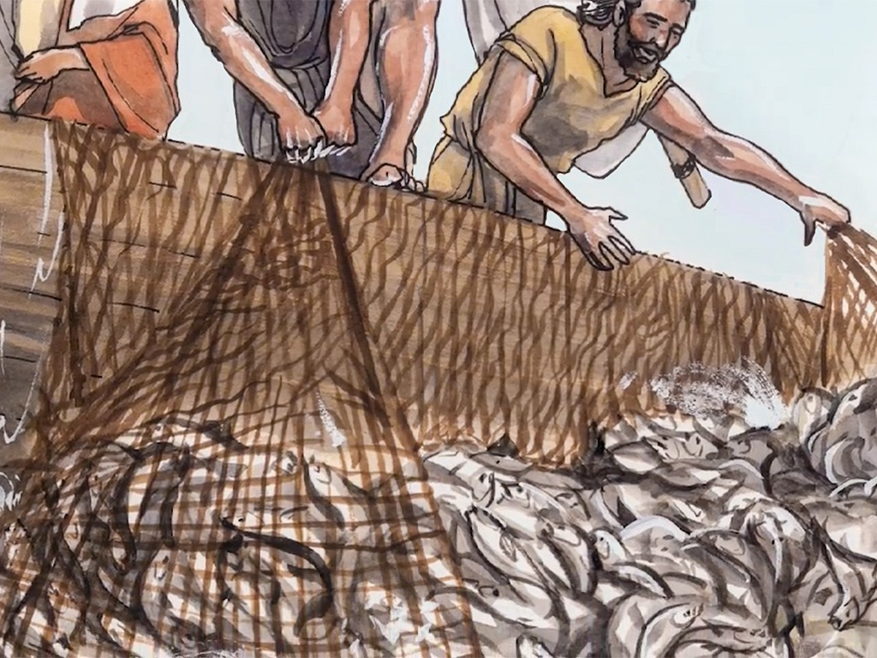
F

Slide 6
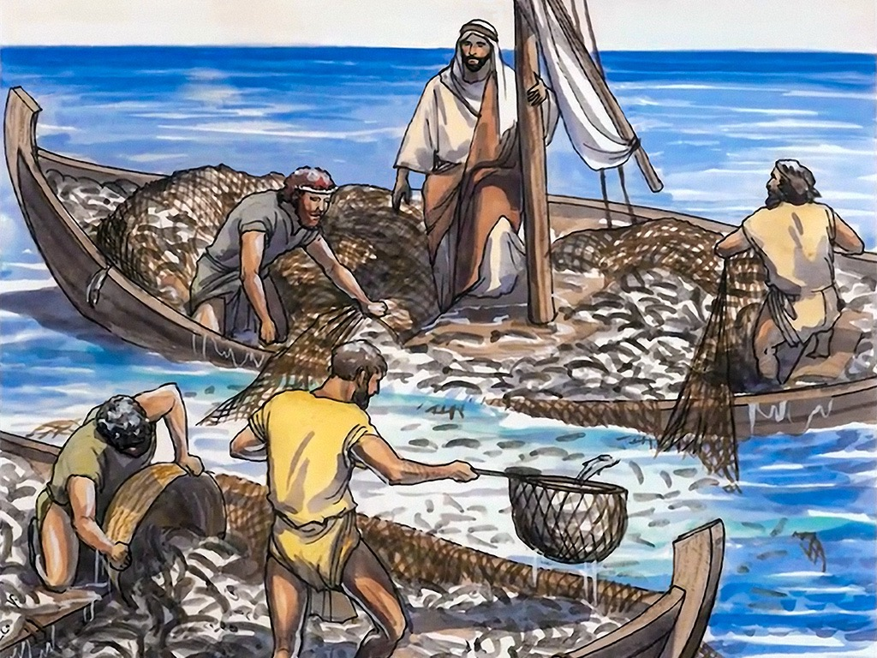
F

